Slide 1

React JS
Petar Kovačević
petar.kovacevic@axilis.com

Slide 2
https://www.netflix.com

Slide 4
...

Slide 6
React JS

Slide 7
Deklarativan

Slide 8
Ako postoji greška – prikaži grešku
Ako se nešto učitava – pokaži spinner
Pokaži zaglavlje
Ako ne postoji greška i ako se ništa ne učitava
Ako lista nije prazna – pokaži todo listu
Ako je lista prazna – "ništa za danas!"

Slide 9
Odlične performanse
(virtual dom)

Slide 10
Baziran na komponentama

Slide 11
<div class="container">
<Header />
<MyTodoList />
<Footer />
</div>

Slide 12
class SimpleComponent extends Component {
render() {
return (
<div>Hello world</div>
);
}
}

Slide 13
<SimpleComponent />

Slide 14
Jednostavan i popularan

Slide 15
https://insights.stackoverflow.com/survey/2018

Slide 16
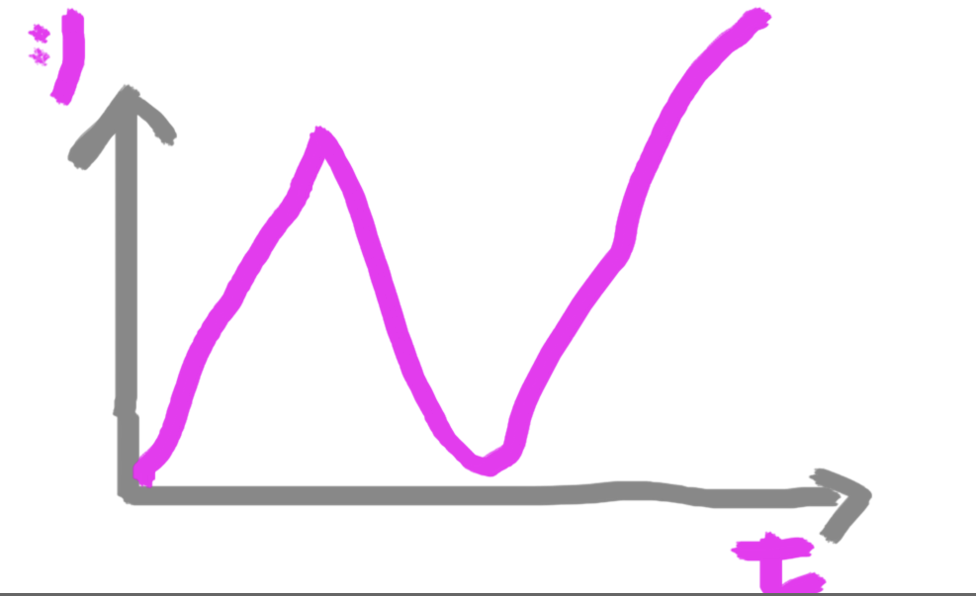
Danas
Samo dvije stvari danas:
Crtanje
Igra sa stanjem aplikacije

Slide 17
React Demo

Slide 19
AppContainer
Todo
Footer
TodoList
App
Header
AddTodo
https://facebook.github.io/react/docs/lifting-state-up.html !!

Slide 20
BodyApp
MovieFilterBox
Movie
AddMovieBox
Footer
MovieList
UserLoginHeader
UserLoginBox
UserDetails
Application
Sidebar
FeaturedMoviesList
TopUsersList
https://facebook.github.io/react/docs/lifting-state-up.html !!

Slide 21

Redux karikirano…
y
BodyApp
MovieFilterBox
Movie
AddMovieBox
Footer
MovieList
UserLoginHeader
UserLoginBox
UserDetails
Application
Sidebar
FeaturedMoviesList
TopUsersList
https://facebook.github.io/react/docs/lifting-state-up.html !!

Slide 22
Kako dalje?
https://reactjs.org/docs/hello-world.html
https://reacttraining.com/react-router/
https://redux.js.org/
Radionica materijali: http://bit.ly/axilis-react
Kod s predavanja: https://github.com/axilis/jsschool-2018

